Slide 1



My Self
Diya Patil
Course : Full Stack Developer

Slide 2



I am Introvert
Calm
Attentive
Quick Learner
Good Listener
Me

Slide 3


I Hate
I hate to get ignored
I hate disrespect and rudeness
Hate to Fights

Slide 4


STRENGTH
WEAKNESS
SWOT
Quite & Honest
Quick Learner
My family
Sensitive
Difficulty to communicate
OPERTUNITY
THREAT
Continued learning and Professional development to expand Skillset.
Potential for Freelancing
New Technology Change Really Fast.. if I dont’t keep learning my skills become old & not useful.

Slide 5



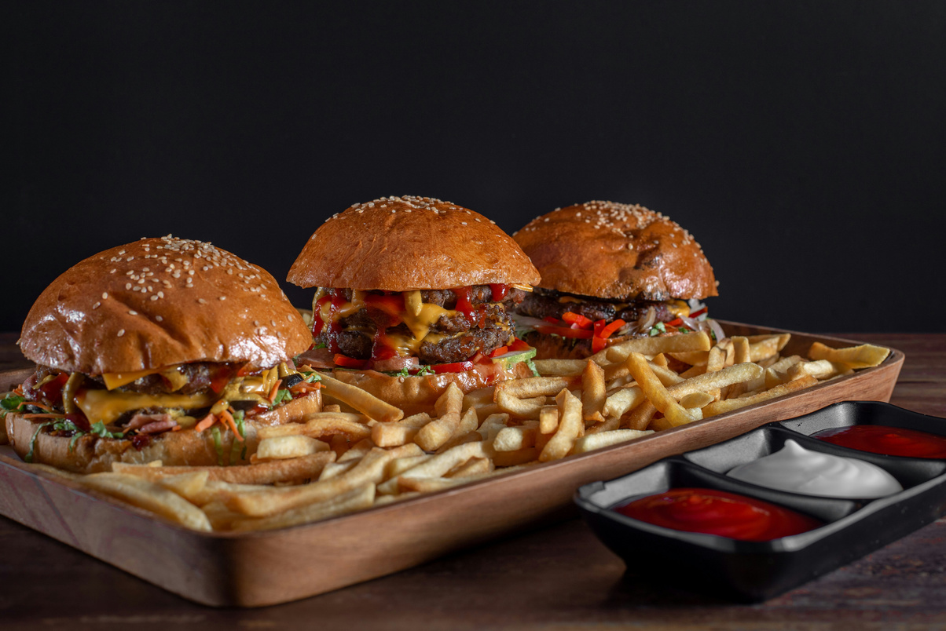


I Love
I love watching movies and discussing them with friends.
I am Foodie
love to watch Cricket

Slide 6

“I belive everything happens for a reason.“
Whether it is good or bad there is purpose behind it.

Slide 7

Thank
you

